Slide 1
Natural Gas Storage Assets Optimization
by
Saurabh Chalke
B00791586
Master of Engineering
Department of Industrial Engineering
07, November 2019

Slide 2
Content:
Overview of Natural Gas (NG) industry
Problem Statement
Key Assumptions
Modeling approach
Linear Programming
Stochastic Linear Programming
Min-Max Regret
Robust Optimization
Deterministic Dynamic Programming
Model Summary
NG storage Graphic User Interface tool
References
07, November 2019

Slide 3
Overview of Natural Gas (NG) Industry:
NG offers a clean and efficient fuel burning method.
Canada is the fourth largest NG producer in the world and as per Canadian Gas Association report dated January’2018, NG meets over 30% of Canada’s energy demand.
The demand for NG across North America varies throughout the year and so its prices.
NG storage assets plays a vital role across all the supply chain elements.
NG storage contracts are evaluated mostly based on the past records and experiences.
07, November 2019

Slide 4
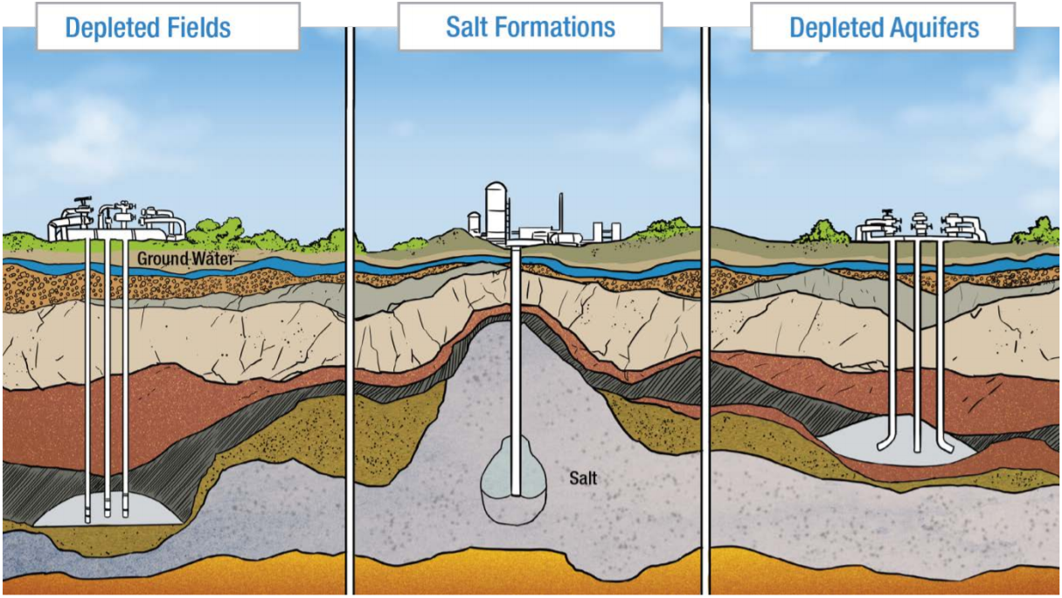
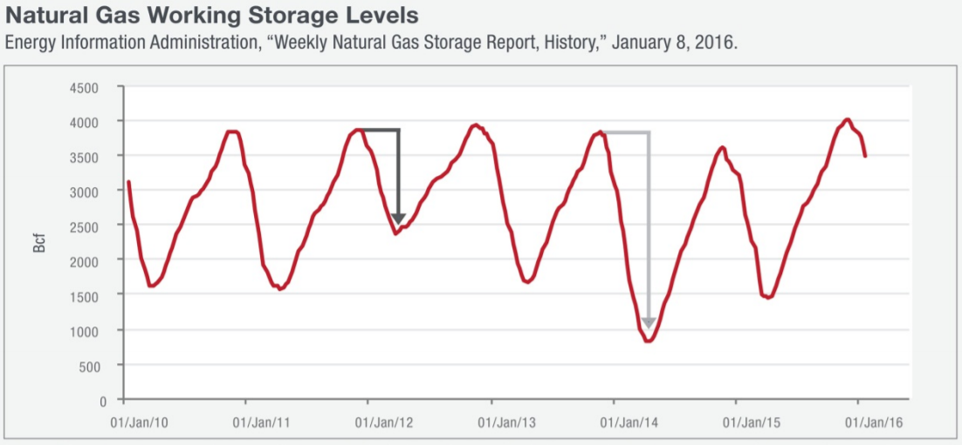
Problem
Statement:
Develop an optimization framework for natural gas storage asset operation using several Linear Programming and Dynamic Programming modeling approaches considering the uncertainty of NG prices.
The primary objective of the project is to maximize the expected profit based on the forecasted price data.
Source: https://www.ingaa.org/File.aspx?id=27274&v=3c5b7072
07, November 2019

Slide 5
Key Assumptions:
Injection and withdrawal of NG can not occur in the same time period.
NG Asset is available for 24 months.
NG Storage asset returns to its initial state at the end of last time period.
Inventory holding cost is ignored.
Loss of NG during injection/withdrawal and evaporation losses are ignored.
07, November 2019

Slide 6
Modeling Approach:
Linear Programming -Average Monthly Price (LP)
Stochastic Linear Programming -K Price Simulations (SLP)
Stochastic Linear Programming with Chance Constraint
Minimizing the Maximum Regret (MMR)
Robust Optimization (RO)
Deterministic Dynamic Programming (DDP)
07, November 2019

Slide 7
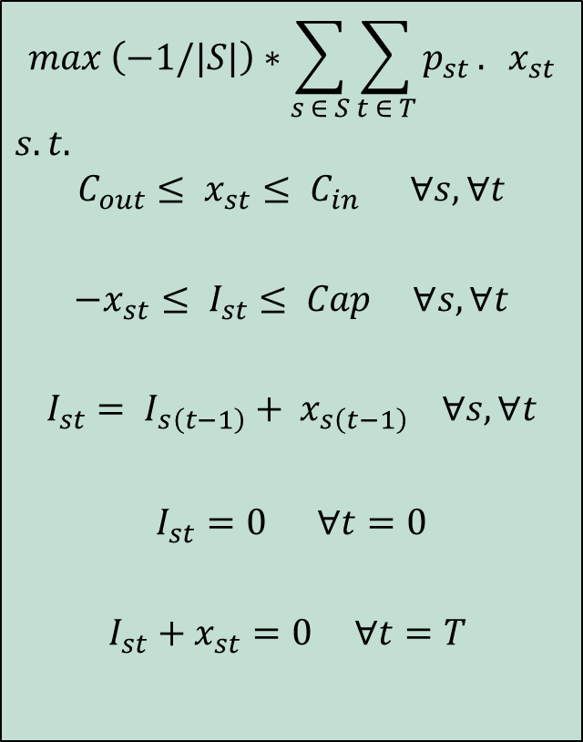
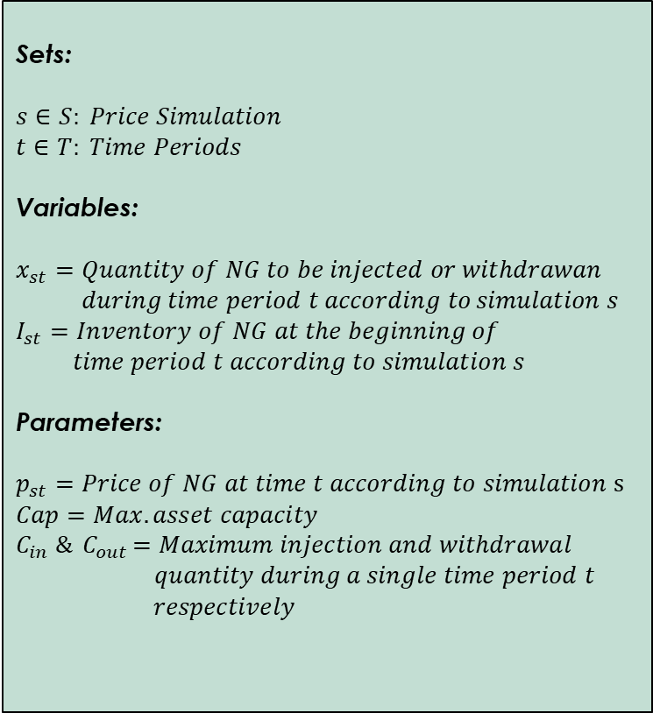
Linear Programming (Average Monthly Price)
$$max \left(−1/|S|\right)∗\sum_{s ∈ S}{\sum_{t ∈ T}{p_{st}}. } x_{st}$$
$$s.t.$$
$$C_{out}≤ x_{st}≤ C_{in} ∀s, ∀t$$
$$−x_{st}≤ I_{st}≤ Cap ∀s, ∀t$$
$$I_{st}= I_{s\left(t−1\right)}+ x_{s\left(t−1\right)} ∀s, ∀t$$
$$I_{st}=0 ∀t=0$$
$$I_{st}+x_{st}=0 ∀t=T$$
Sets:
$$s∈S: Price Simulation$$
$$t∈T: Time Periods$$
Variables:
$$x_{st}=Quantity of NG to be injected or withdrawan$$
$during time period t according to$ $simulation s$
$$I_{st}=Inventory of NG at the beginning of$$
$time period t according to simulation s$
Parameters:
$$p_{st}=Price of NG at time t according to simulation s$$
$$Cap=Max. asset capacity$$
$$C_{in} \&{ C}_{out}=Maximum injection and withdrawal$$
$quantity during a single time period t$
$respectively$
07, November 2019

Slide 8
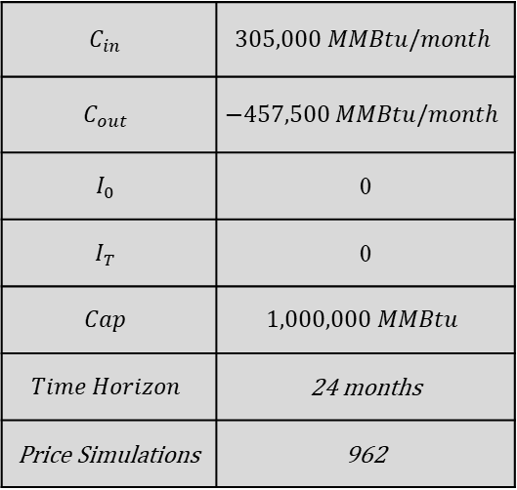
Linear Programming (Average Monthly Price) (Cont’d)
Operating Characteristics:
$$C_{in}$$ | $$305,000 MMBtu/month$$
$$C_{out}$$ | $$−457,500 MMBtu/month$$
$$I_{0}$$ | 0
$$I_{T}$$ | 0
$$Cap$$ | $$1,000,000 MMBtu$$
$$Time Horizon$$ | 24 months
Price Simulations | 962
Expected Profit: $ 534,555/-
Computational Time: 1.875 sec.
07, November 2019

Slide 9




Model Summary
07, November 2019

Slide 10
Modeling Approach:
Linear Programming -Average Monthly Price (LP)
Stochastic Linear Programming -K Price Simulations (SLP)
Stochastic Linear Programming with Chance Constraint
Minimizing the Maximum Regret (MMR)
Robust Optimization (RO)
Deterministic Dynamic Programming (DDP)
07, November 2019

Slide 11

Stochastic Linear Programming (K Price Simulations)
Converting the $n$ price scenarios into definite number of price vectors (scenarios) using K-Means Clustering Algorithm
Steps:
Initial cluster assignment: Randomly assign a number, from 1 to K, to each of the observations.
Calculate the mean for all the clusters (mean of cluster K is the vector of p features).
Re-assign the observations to the nearest mean.
Iterate the step 2 and 3 until the cluster assignments stop changing.
07, November 2019

Slide 12
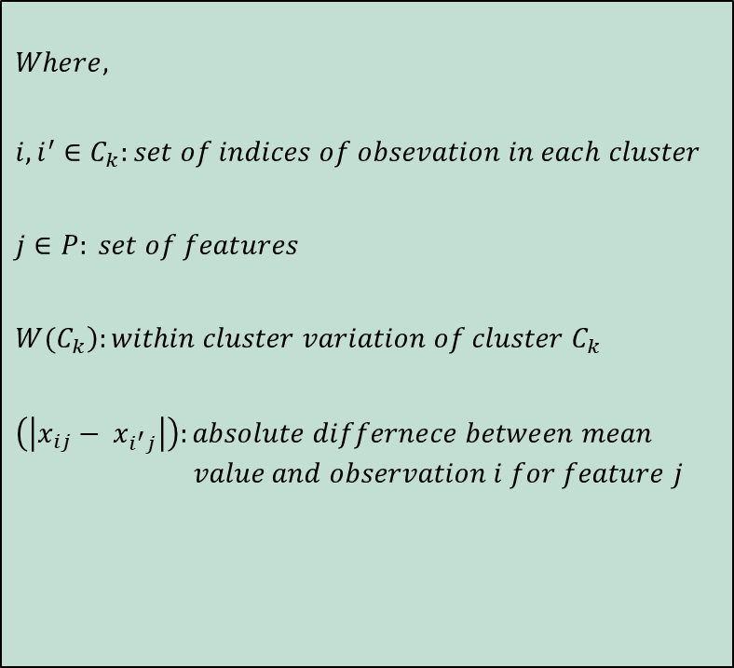
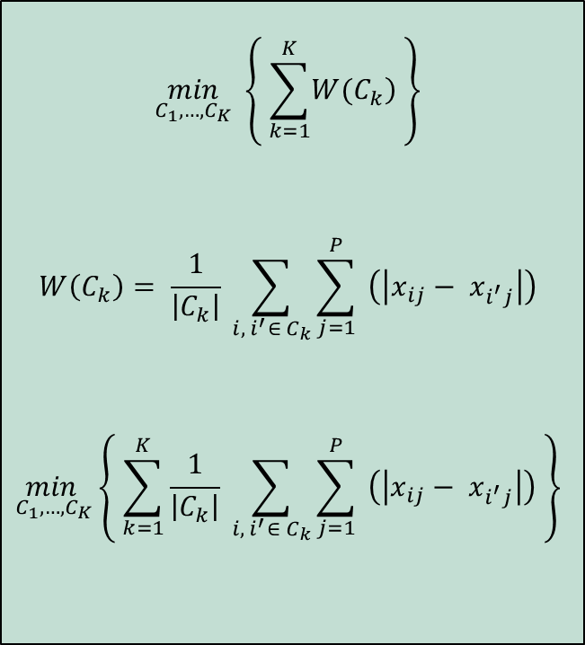
Stochastic Linear Programming (K Price Simulations) (Cont’d)
A good clustering is one for which the within-cluster variation is as small as possible.
$$\min_{C_{1},…, C_{K}} \left\{ \sum_{k=1}^{K}{\left.W(C_{k}\right)} \right\}$$
$$W\left(C_{k}\right)= \frac{1}{\left|C_{k}\right|} \sum_{i, { i}^{′}∈ C_{k}}{\sum_{j=1}^{P}{ \left(\left|x_{ij}− x_{i^{′}j}\right|\right)}}$$
$$\min_{C_{1},…, C_{K}}\left\{ \sum_{k=1}^{K}{\frac{1}{\left|C_{k}\right|} \sum_{i, { i}^{′}∈ C_{k}}{\sum_{j=1}^{P}{ \left(\left|x_{ij}− x_{i^{′}j}\right|\right)}}} \right\}$$
$$Where,$$
$$i,i^{′}∈C_{k}:set of indices of obsevation in each cluster$$
$$j∈P: set of features$$
$$\left.W(C_{k}\right):within cluster variation of cluster C_{k}$$
$$\left(\left|x_{ij}− x_{i^{′}j}\right|\right):absolute differnece between mean$$
$$value and observation i for feature j$$
07, November 2019

Slide 13
Stochastic Linear Programming (K Price Simulations)
(Cont’d)
Deriving the Optimum number of price scenarios using “Elbow Method”
07, November 2019

Slide 14

Stochastic Linear Programming (K Price Simulations)
(Cont’d)
Calculating the Cluster (Scenario) Probability ${(q}_{s})$:
$$q_{s}{=\frac{Cluster Size}{Total \#Observations}= \frac{\left|C_{k}\right|}{\left|N\right|}} ∀k=1,…,9$$
 | C1 | C2 | C3 | C4 | C5 | C6 | C7 | C8 | C9
Cluster size: | 2 | 37 | 89 | 8 | 143 | 294 | 110 | 41 | 238
Total #Observations: | 962 | 962 | 962 | 962 | 962 | 962 | 962 | 962 | 962
Cluster Probability: | 0.002 | 0.038 | 0.093 | 0.008 | 0.149 | 0.306 | 0.114 | 0.043 | 0.247
07, November 2019

Slide 15
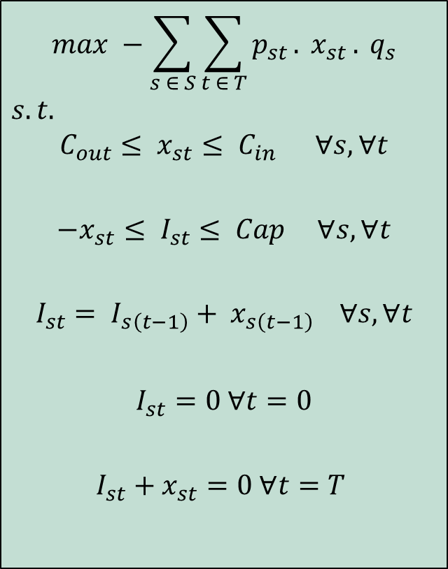
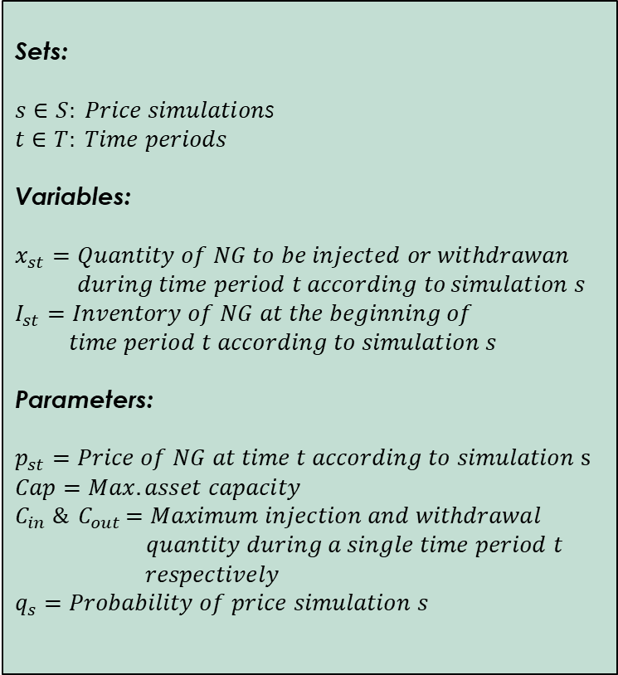
Stochastic Linear Programming (K Price Simulations) (Cont’d)
$$max −\sum_{s ∈ S}{\sum_{t ∈ T}{p_{st}}. }x_{st }{. q}_{s}$$
$$s.t.$$
$$C_{out}≤ x_{st}≤ C_{in} ∀s, ∀t$$
$$−x_{st}≤ I_{st}≤ Cap ∀s, ∀t$$
$$I_{st}= I_{s\left(t−1\right)}+ x_{s\left(t−1\right)} ∀s, ∀t$$
$$I_{st}=0 ∀t=0$$
$$I_{st}+x_{st}=0 ∀t=T$$
Sets:
$s∈S: Price simulation$s
$$t∈T: Time periods$$
Variables:
$$x_{st}=Quantity of NG to be injected or withdrawan$$
$during time period t according to$ $simulation s$
$$I_{st}=Inventory of NG at the beginning of$$
$time period t according to simulation s$
Parameters:
$$p_{st}=Price of NG at time t according to simulation s$$
$$Cap=Max. asset capacity$$
$$C_{in} \&{ C}_{out}=Maximum injection and withdrawal$$
$quantity during a single time period t$
$respectively$
$$q_{s}=Probability of price simulation s$$
07, November 2019

Slide 16
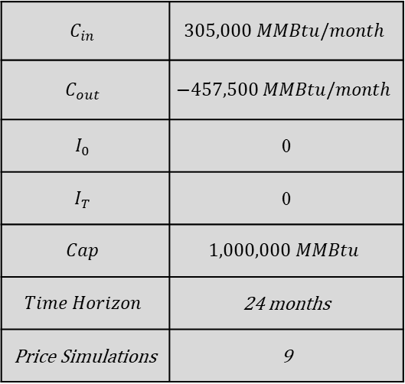
Stochastic Linear Programming -K Price Simulations (SLP) (Cont’d)
Operating Characteristics:
$$C_{in}$$ | $$305,000 MMBtu/month$$
$$C_{out}$$ | $$−457,500 MMBtu/month$$
$$I_{0}$$ | 0
$$I_{T}$$ | 0
$$Cap$$ | $$1,000,000 MMBtu$$
$$Time Horizon$$ | 24 months
Price Simulations | 9
Expected Profit: $ 534,638/-
Computational Time: 2.33 sec.
07, November 2019

Slide 17
Model Summary
07, November 2019

Slide 18
Modeling Approach:
Linear Programming -Average Monthly Price (LP)
Stochastic Linear Programming -K Price Simulations (SLP)
Stochastic Linear Programming with Chance Constraint
Minimizing the Maximum Regret (MMR)
Robust Optimization (RO)
Deterministic Dynamic Programming (DDP)
07, November 2019

Slide 19
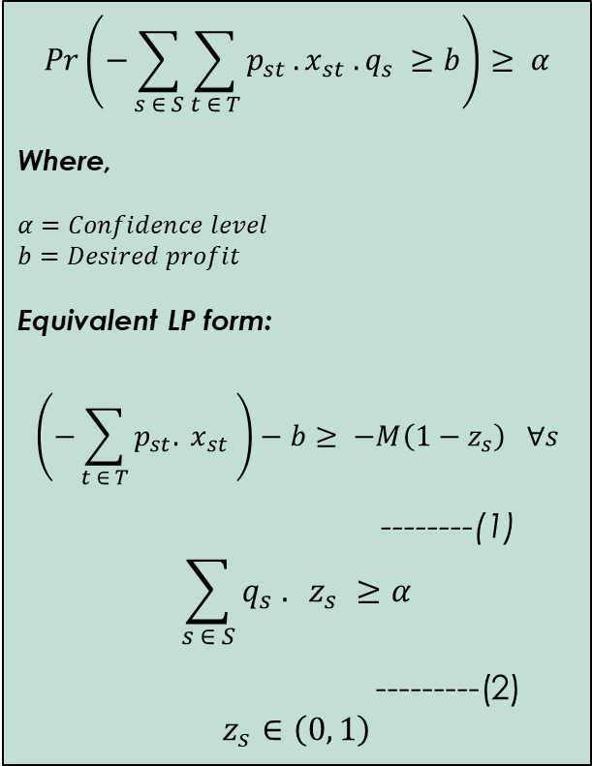
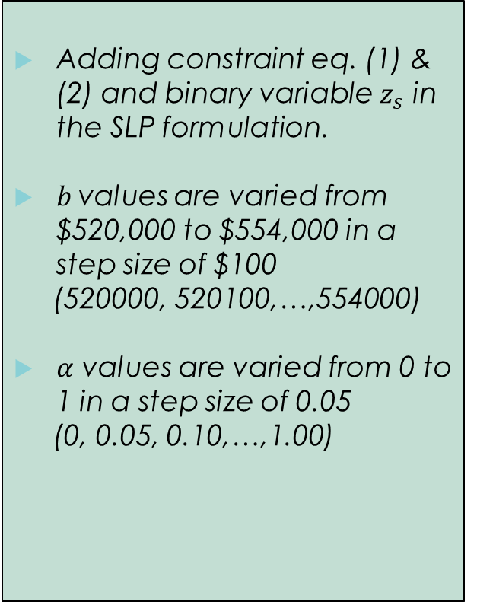
Stochastic Linear Programming with Chance Constraint
$$Pr\left(−\sum_{s ∈ S}{\sum_{t ∈ T}{p_{st}}.}x_{st} . q_{s} ≥b\right)≥ α$$
Where,
$$α=Confidence level$$
$$b=Desired profit$$
Equivalent LP form:
$$\left(−\sum_{t ∈ T}{p_{st}. }x_{st} \right)−b≥ −M\left(1−z_{s}\right) ∀s$$
--------(1)
$$\sum_{s ∈ S}{q_{s} . } z_{s} ≥α$$
---------(2)
$$z_{s}∈\left(0, 1\right)$$
Adding constraint eq. (1) & (2) and binary variable $z_{s}$ in the SLP formulation.
$b$values are varied from $520,000 to $554,000 in a step size of $100
(520000, 520100,…,554000)
$α$ values are varied from 0 to 1 in a step size of 0.05
(0, 0.05, 0.10,…,1.00)
07, November 2019

Slide 20
Stochastic Linear Programming with Chance Constraint (Cont’d)
Expected Profit as per SLP = $ 534,638/-
Computational Time: 6.95 minutes
07, November 2019

Slide 21
Modeling Approach:
Linear Programming -Average Monthly Price (LP)
Stochastic Linear Programming -K Price Simulations (SLP)
Stochastic Linear Programming with Chance Constraint
Minimizing the Maximum Regret (MMR)
Robust Optimization (RO)
Deterministic Dynamic Programming (DDP)
07, November 2019

Slide 22


Minimizing the Maximum Regret (MMR)
Steps:
Solving the LP for K-price scenarios individually to get the vector data ${\overline{x}}_{st}$as an input to the Min-Max Regret model.
Solving Min-Max Regret model using ${\overline{x}}_{st}$vectors as parameters
$$max −\sum_{s ∈ S}{\sum_{t ∈ T}{p_{st}}. }x_{st} ∀s$$
$$s.t.$$
$$C_{out}≤ x_{st}≤ C_{in} ∀s, ∀t$$
$$−x_{st}≤ I_{st}≤ Cap ∀s, ∀t$$
$$I_{st}= I_{s\left(t−1\right)}+ x_{s\left(t−1\right)} ∀s, ∀t$$
$$I_{st}=0 ∀t=0$$
$$I_{st}+x_{st}=0 ∀t=T$$
07, November 2019

Slide 23

Minimizing the Maximum Regret (MMR) (Cont’d)
Steps:
Solving the LP for K-price scenarios individually to get the vector data ${\overline{x}}_{st}$as an input to the Min-Max Regret model.
Solving Min-Max Regret model using ${\overline{x}}_{st}$vectors as parameters
$$minimize r$$
$$s.t.$$
$$−\sum_{t ∈ T}{p_{st} .}x_{t}+r ≥−\sum_{t ∈ T}{p_{st} .}{\overline{x}}_{st} ∀s$$
$$r≥0$$
$$C_{out}≤ x_{st}≤ C_{in} ∀s, ∀t$$
$$−x_{st}≤ I_{st}≤ Cap ∀s, ∀t$$
$$I_{st}= I_{s\left(t−1\right)}+ x_{s\left(t−1\right)} ∀s, ∀t$$
$$I_{st}=0 ∀t=0$$
$$I_{st}+x_{st}=0 ∀t=T$$
07, November 2019

Slide 24
Minimizing the Maximum Regret (MMR) (Cont’d)
LP (962 Scenarios)
SLP (9 Scenarios)
Expected Profit: $ 499,684/-
Computational Time: 546.50 sec.
Expected Profit: $ 534,517/-
Computational Time: 2.47 sec.
07, November 2019

Slide 25
Model Summary
07, November 2019

Slide 26
Modeling Approach:
Linear Programming -Average Monthly Price (LP)
Stochastic Linear Programming -K Price Simulations (SLP)
Stochastic Linear Programming with Chance Constraint
Minimizing the Maximum Regret (MMR)
Robust Optimization (RO)
Deterministic Dynamic Programming (DDP)
07, November 2019

Slide 27
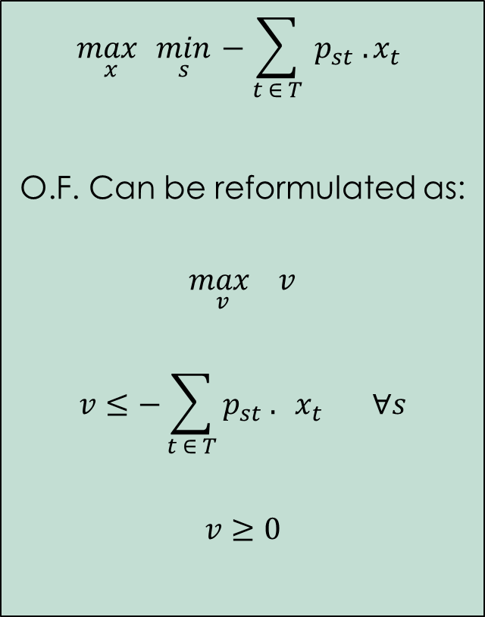
Robust Optimization (RO)
$$\max_{x}\min_{s}−\sum_{t ∈ T}{{ p}_{st} .}x_{t}$$
O.F. Can be reformulated as:
$$\max_{v} v$$
$$v≤−\sum_{t ∈ T}{p_{st} . } x_{t} ∀s$$
$$v≥0$$
Sets:
$s∈S: Price simulation$s
$$t∈T: Time periods$$
Variables:
$$x_{st}=Quantity of NG to be injected or withdrawan$$
$during time period t according to$ $simulation s$
$$I_{st}=Inventory of NG at the beginning of$$
$time period t according to simulation s$
Parameters:
$$p_{st}=Price of NG at time t according to simulation s$$
$$Cap=Max. asset capacity$$
$$C_{in} \&{ C}_{out}=Maximum injection and withdrawal$$
$quantity during a single time period t$
$respectively$
$$q_{s}=Probability of price simulation s$$
07, November 2019

Slide 28
Robust Optimization (RO) (Cont’d)
LP (962 Scenarios)
SLP (9 Scenarios)
Expected Profit: $ 430,790/-
Computational Time: 2.87 sec.
Expected Profit: $ 520,449/-
Computational Time: 2.14 sec.
07, November 2019

Slide 29
Model Summary
07, November 2019

Slide 30
Model Summary
07, November 2019

Slide 31
Modeling Approach:
Linear Programming -Average Monthly Price (LP)
Stochastic Linear Programming -K Price Simulations (SLP)
Stochastic Linear Programming with Chance Constraint
Minimizing the Maximum Regret (MMR)
Robust Optimization (RO)
Deterministic Dynamic Programming (DDP)
07, November 2019

Slide 32

“Given the current state, an optimal policy for the remaining stages is independent of the policy decisions adopted in previous stages. Therefore, the optimal immediate decision depends on only the current state and not on how you got there. This is the principle of optimality for dynamic programming”.
Deterministic Dynamic Programming (DDP) (Cont’d)
Steps:
Discreet States, Stages, and Policy variables
Perform backward recursion
Optimal decisions for all stages
Calculate the expected profit
$Discreet set of policy variables: x_{i}∈I (NG injection values)$
$Discreet set of state variables:s_{j}∈J (NG storage values)$
$Set of stages: t∈T (Time periods)$
07, November 2019

Slide 33
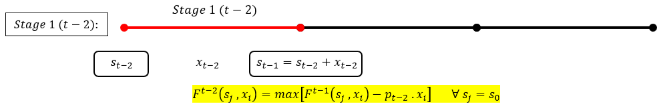
Deterministic Dynamic Programming (DDP) (Cont’d)
Backward Recursion
Optimal Decisions
07, November 2019

Slide 34
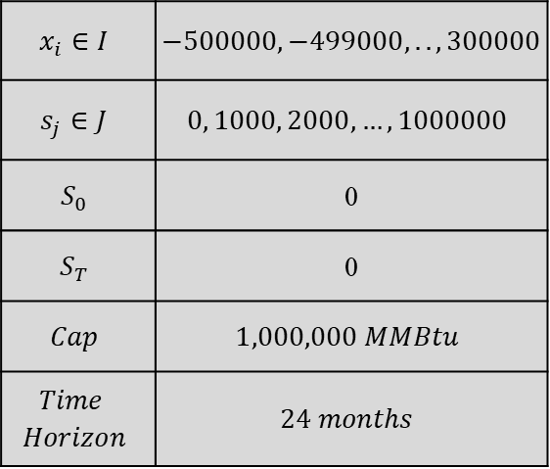
Deterministic Dynamic Programming (DDP) (Cont’d)
32
Operating Characteristics:
$$x_{i}∈I$$ | $$−500000, −499000,.., 300000$$
$$s_{j}∈J$$ | $$0, 1000, 2000, …,1000000$$
$$S_{0}$$ | 0
$$S_{T}$$ | 0
$$Cap$$ | $$1,000,000 MMBtu$$
$$Time$$ $$Horizon$$ | $$24 months$$
Expected Profit: $ 555,809/-
Computational Time: 18553.9 sec. ~ 5hrs.
07, November 2019

Slide 35
Model Summary
07, November 2019

Slide 36
NG Storage Asset User Interface Tool
Click Here
07, November 2019

Slide 37
References:
Mausser H. and Laguna M. A New Mixed Integer Formulation for the Maximum Regret Problem. International Transactions in Operational Research Vol. 5, No. 5, pp. 389-403,1998
Avery W., Brown G. G., Rosenkranz J. A. & Wood R. K. (1992). Optimization of Purchase, Storage and Transmission Contracts for Natural Gas Utilities. Operations Research, 40(3), 446-462. doi:10.1287/ opre.40.3.446
F. Hillier & G. Lieberman. Introduction to Operations Research-Chapter 7 & 11.
Nandalal K. & Bogardi J. Dynamic programming-based operation of reservoirs. Cambridge University Press
G. James, D. Witten, T. Hastie & R. Tibshirani. An Introduction to Statistical Learning. Chapter 10.
https://www.nrcan.gc.ca/science-data/data-analysis/energy-data-analysis/energy-facts/natural-gas-facts/20067
07, November 2019

Slide 38


07, November 2019

